Slide 1
Web Design Principles
5th Edition
Chapter Three
Planning the Site

Slide 2
Objectives
When you complete this chapter, you will be able to:
Understand the Web site development process
Create a site specification
Identify the content goal
Analyze your audience
Build a Web site development team
Web Design Principles 5th Ed.

Slide 3
Understanding the Web Site Development Process

Slide 4
Understanding the Web Site Development
You need a good project plan
Larger projects need a project manager
Adopt a development framework
The project life cycle encompasses the entire project from start to finish
Web Design Principles 5th Ed.

Slide 5
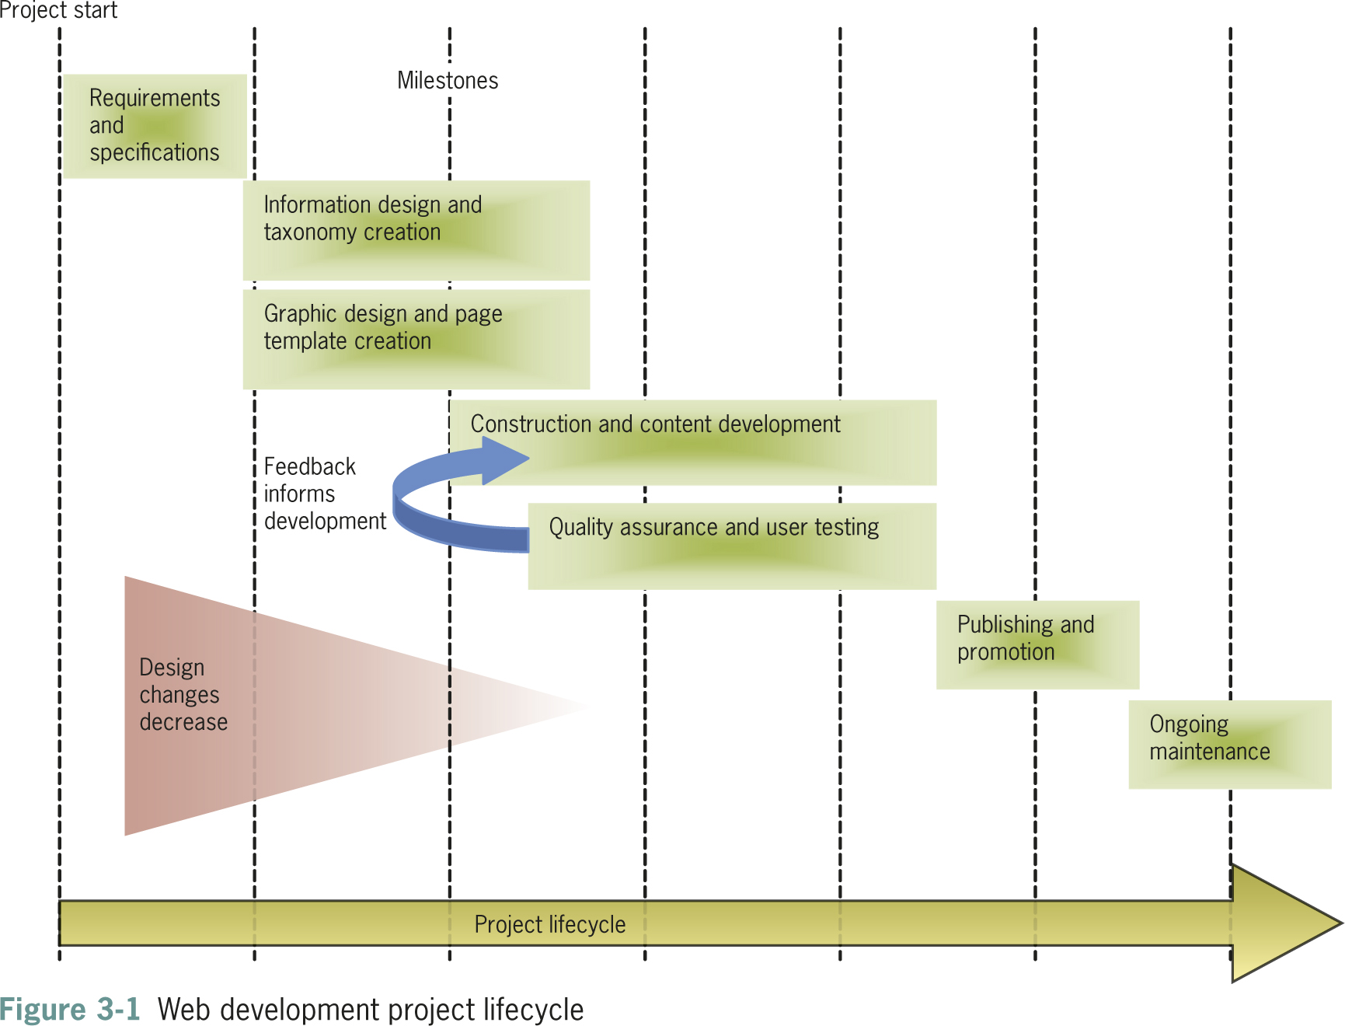
Web Design Principles 5th Ed.

Slide 6
Requirements and Specification
The client presents the requirements for the site
Requirements are the list of customer needs
The project team breaks the requirements down to tasks
The team prepares a project specification that contains:
  Page layout sketches
  Audience definition
  Technical requirements
Web Design Principles 5th Ed.

Slide 7
Information Design and Taxonomy Creation
User analysis guides the design of site content
Goal is to create meaningful content navigation
Taxonomy is a classification and naming of contents in a hierarchy
The taxonomy of the site structures the topic hierarchy and navigation
Web Design Principles 5th Ed.

Slide 8
Graphic Design and Page Template Creation
Designers prepare sketches and page mockups to represent page layouts
All page layouts start with a mockup
Mockups can be easily edited based on feedback
Wireframes document a more stable page design
Wireframes offer a more complete view of what the final design will look like
Web Design Principles 5th Ed.

Slide 9
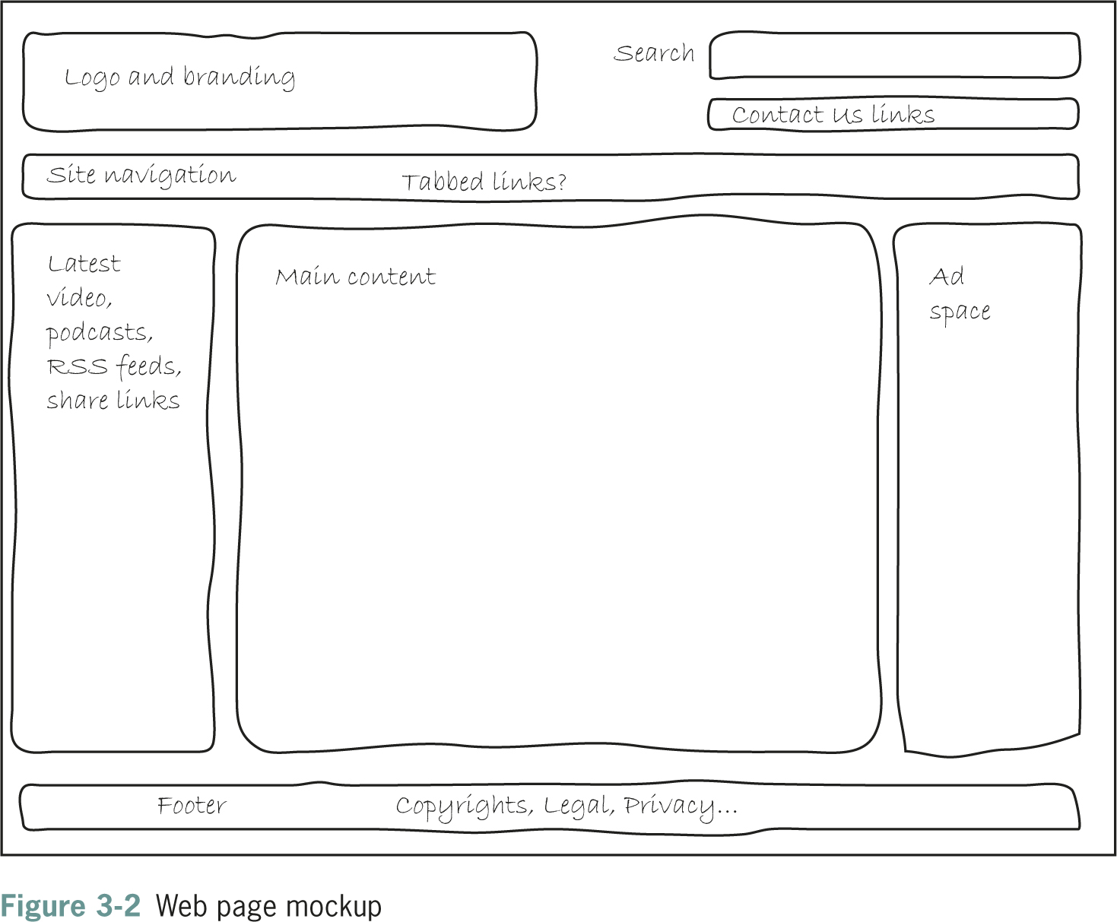
Web Design Principles 5th Ed.

Slide 10
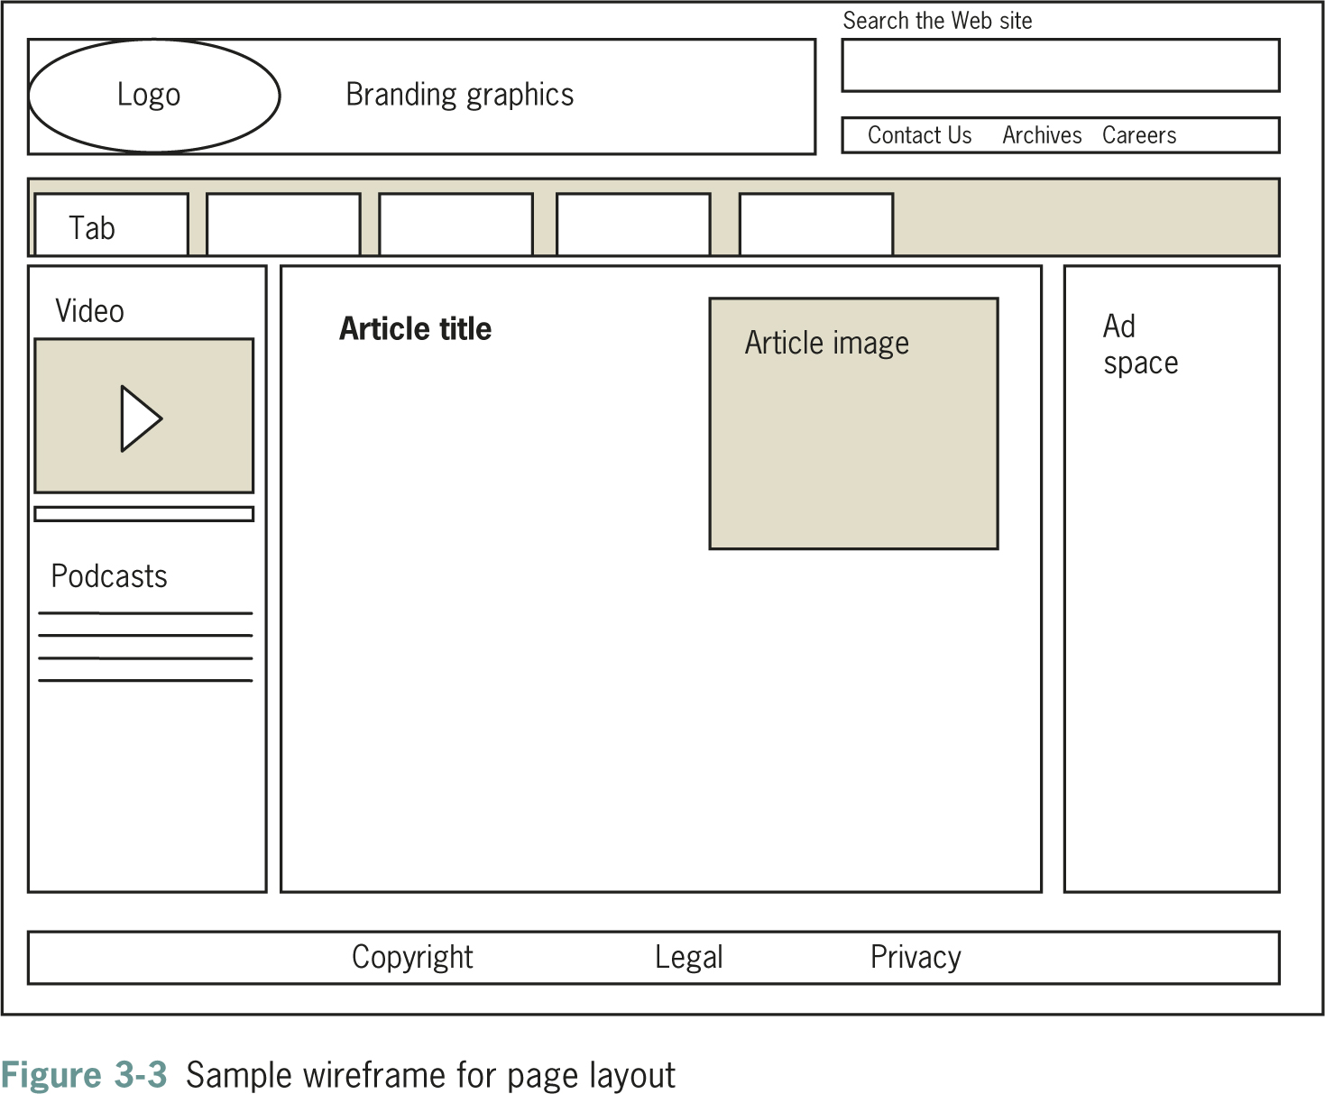
Web Design Principles 5th Ed.

Slide 11
Construction and Content Development
Construction begins when the design stage is mostly complete
This stage includes technical development of the site
Some testing will occur during this stage
Web Design Principles 5th Ed.

Slide 12
Quality Assurance and User Testing
Quality assurance validates the technology of the site
User testing validates the design
Cross-platform testing and usability testing ensure users can access content easily
Web Design Principles 5th Ed.

Slide 13
Publishing and Promotion
The site is published to the Web
Promotion of the site begins
Web Design Principles 5th Ed.

Slide 14
Ongoing Maintenance
Starts when the site goes live and continues throughout the life of the project
Web Design Principles 5th Ed.

Slide 15
Creating a Site Specification

Slide 16
Creating a Site Specification
Who is the client for the site?
Can you write a two- or three-paragraph mission statement that briefly states the site’s goals?
What do you envision as the goal of the site?
What do you (or your company or organization) hope to gain from creating and maintaining a Web site?
What are the requirements for the Web site?
Web Design Principles 5th Ed.

Slide 17
Creating a Site Specification
Are the requirements feasible?
How will you judge the success of the site?
Who is the target audience?
What are the limiting technical factors?
What is the budget?
Is this a new site or an upgrade?
Web Design Principles 5th Ed.

Slide 18
Identifying the Content Goal

Slide 19
Identifying the Content Goal
Examine closely what type of site you are building
Your objectives and your users’ objectives may be quite different
Adopt your users’ perspective
Think about the type of content you’re presenting and look to the Web for examples of how best to present it
Web Design Principles 5th Ed.

Slide 20
Identifying the Content Goal
Types of Web sites:
  Billboard
  Publishing
  Portal
  Special interest
  Blog
  Social networking
Web Design Principles 5th Ed.

Slide 21
Identifying the Content Goal
  Wikis
  RSS
  Virtual gallery
  E-commerce, catalog, online shopping
  Product support
  Intranet/Extranet
Web Design Principles 5th Ed.

Slide 22
Analyzing Your Audience

Slide 23
Analyzing Your Audience
Produce an audience definition:
  What is it that users want when they come to your site?
  How can you attract them and entice them to return for repeat visits?
  What type of computer and connection speed do your typical visitors have?
Web Design Principles 5th Ed.

Slide 24
Analyzing Your Audience
Who are the typical members of your audience?
  Are they male or female?
  What level of education do they have?
  What is their reading and vocabulary level?
  What level of technical aptitude do they have?
Why do people come to your site?
  Do they want information?
  Do they want to download files?
  Are they looking for links to other Web sites?
Web Design Principles 5th Ed.

Slide 25
Using Web Analytics
Web analytics are statistics gathered by Web servers
Reporting tools can analyze the statistics
You can track user activity on your Web site
You can see where your visitors come from and which pages they like the best
Web Design Principles 5th Ed.

Slide 26
Identifying Technology Issues and Accessibility Constraints
Think about where users are located and what their technology level might be
Test in different environments and with different technologies
Consider the physical capabilities of your users
Web Design Principles 5th Ed.

Slide 27
Identifying Technology Issues and Accessibility Constraints
You can identify accessibility constraints
Review the WCAG 2.0 and section 508 guidelines
In new sites, plan for accessibility
In existing sites, assess the current accessibility
Look to other real-life accessibility implementations
Web Design Principles 5th Ed.

Slide 28
Identifying Software Tools
Try to use software that matches the complexity needs of your site
Move up to more advanced tools as your skills grow
Learn to use graphics tools as well
Look to shareware and freeware options
Web Design Principles 5th Ed.

Slide 29
Building a Website Development Team

Slide 30
Building a Web Site Development Team
Project managers
HTML developers
Designers
Writers and information designers
Application developers
Database administrators
Server administrators
Web Design Principles 5th Ed.

Slide 31
Creating Conventions for Filenames and URLs
Plan the filename conventions for your site
Find out which operating system your server uses
Make sure file structures are transferable from development machines to the Web server
Web Design Principles 5th Ed.

Slide 32
Naming Files
File naming conventions vary across operating systems
The ISO 9660 standard works across all operating systems
Leave out special characters
Use the correct file extensions
Use underscores instead of spaces
Use all lowercase letters
Web Design Principles 5th Ed.

Slide 33
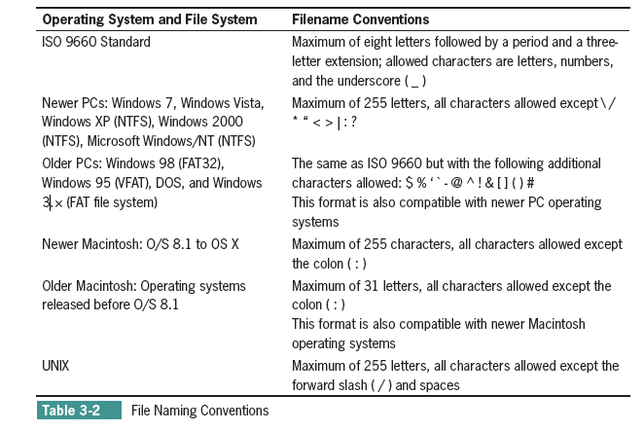
Web Design Principles 5th Ed.

Slide 34
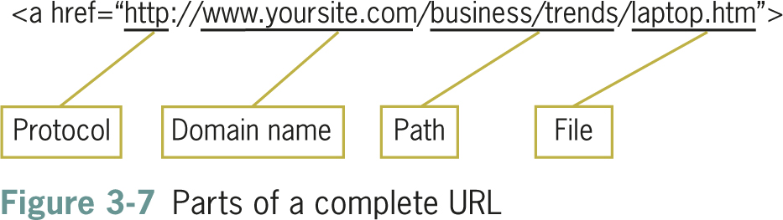
Using Complete or Partial URLs
Complete URLs are the unique address of a file on the Web
Web Design Principles 5th Ed.

Slide 35
Using Complete or Partial URLs
Partial URLs locate a file that resides on your own computer or server
<a href="laptop.htm">link text</a>
Web Design Principles 5th Ed.

Slide 36
Setting a Directory Structure
You build a site on a development computer but host it on a different computer
The files for your Web site must be transferred from the development computer to the hosting computer
Your file structure must be transferable
Use relative paths to indicate file locations
Web Design Principles 5th Ed.

Slide 37
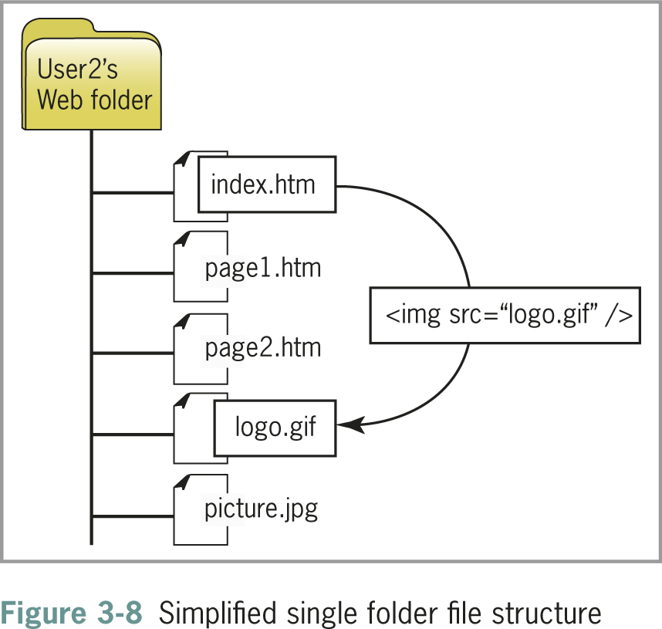
Single Folder Structure
All files are contained in the same folder
Web Design Principles 5th Ed.

Slide 38
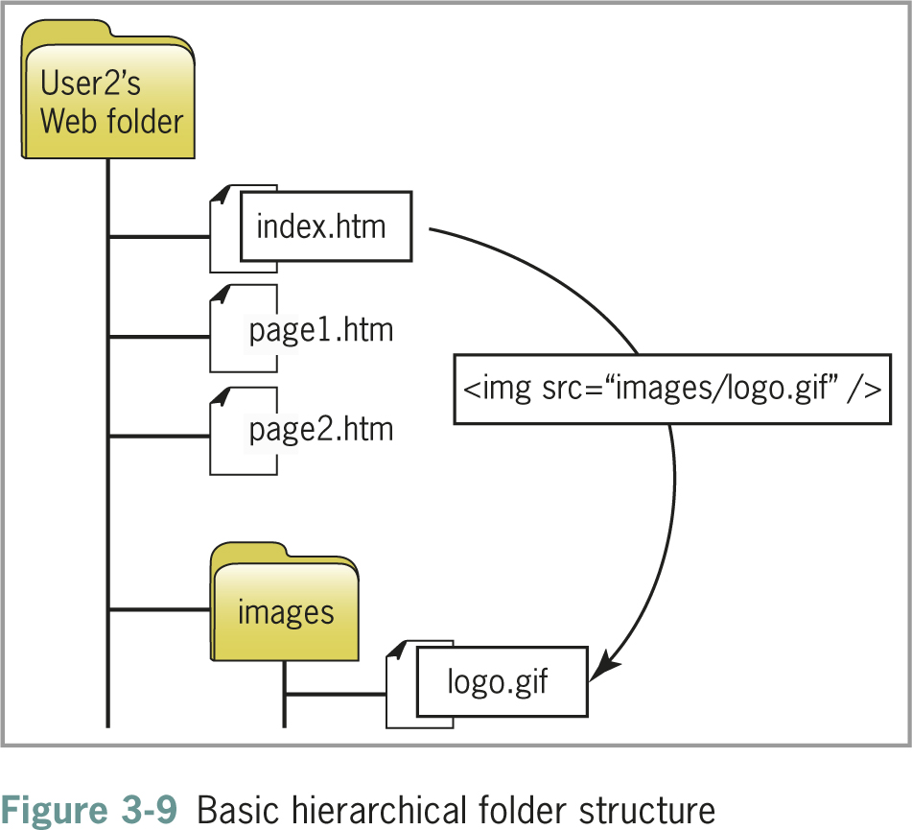
Hierarchical Folder Structure
Content is separated into different folders
Web Design Principles 5th Ed.

Slide 39
Creating a Site Storyboard
Plan your site by creating a storyboard flowchart
The flowchart shows structure logic and taxonomy
This is an important planning step
You can visualize and refine your site design
Web Design Principles 5th Ed.

Slide 40
Organizing Information Structure
Think about your users’ information needs
How should your information design map look?
Review the following sample structures and adapt them to information needs
Web Design Principles 5th Ed.

Slide 41
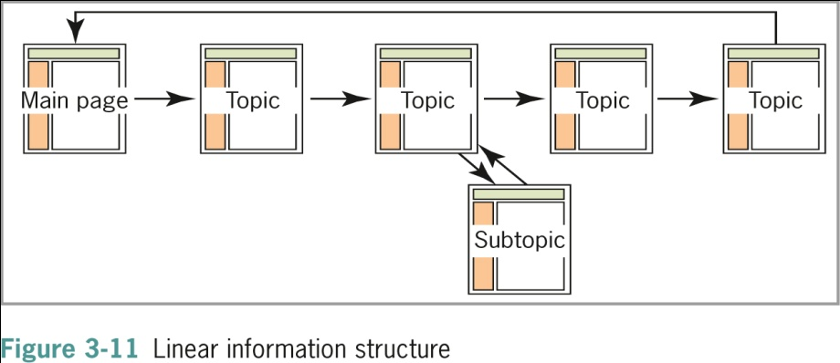
Linear Structure
Web Design Principles 5th Ed.

Slide 42
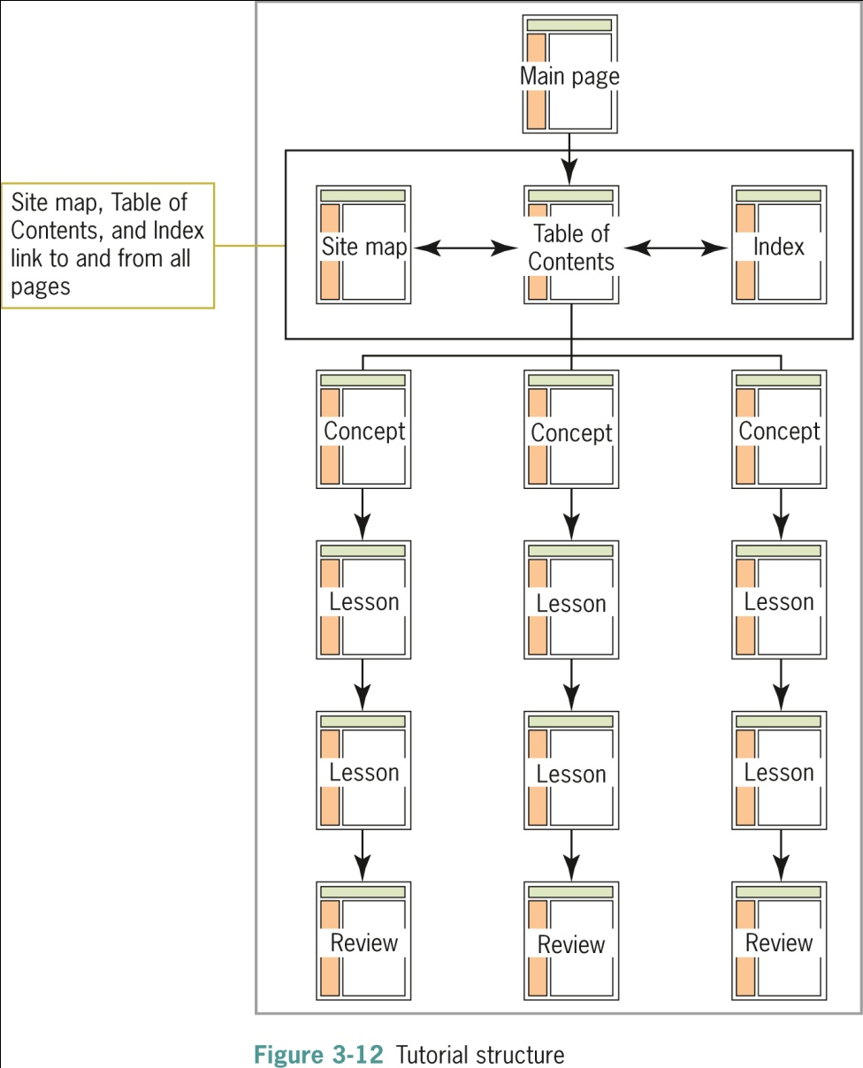
Tutorial Structure
Web Design Principles 5th Ed.

Slide 43
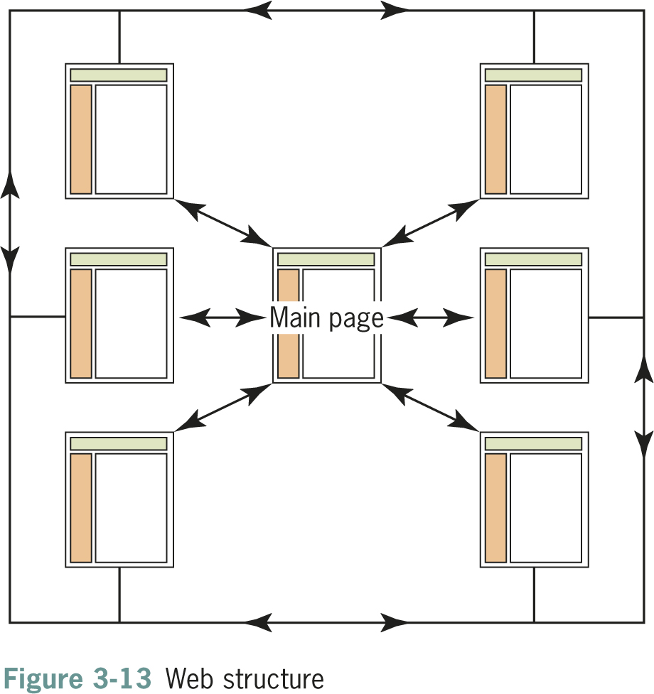
Web Structure
Web Design Principles 5th Ed.

Slide 44
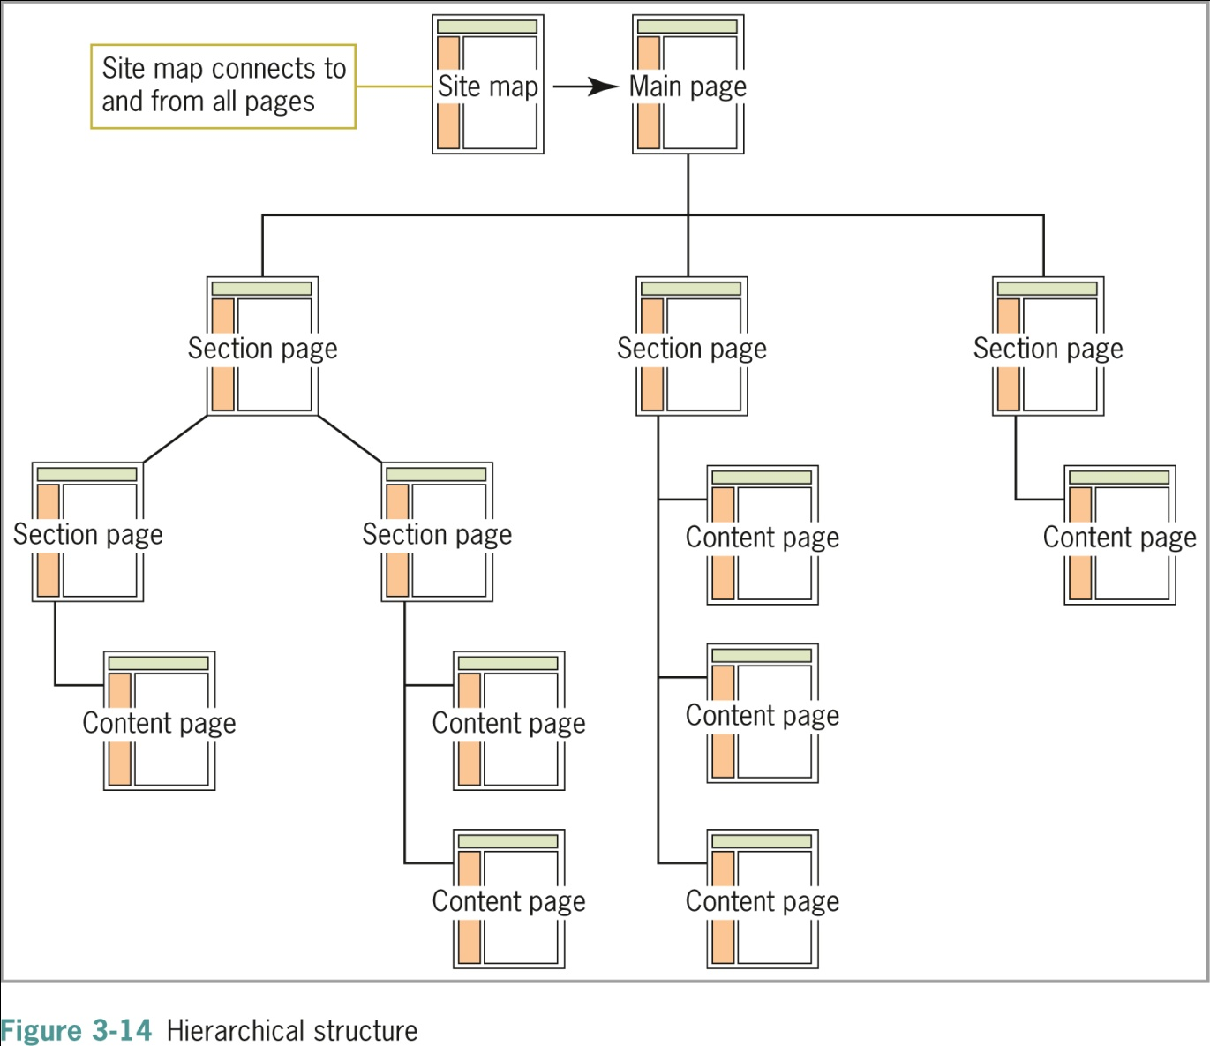
Hierarchical Structure
Web Design Principles 5th Ed.

Slide 45
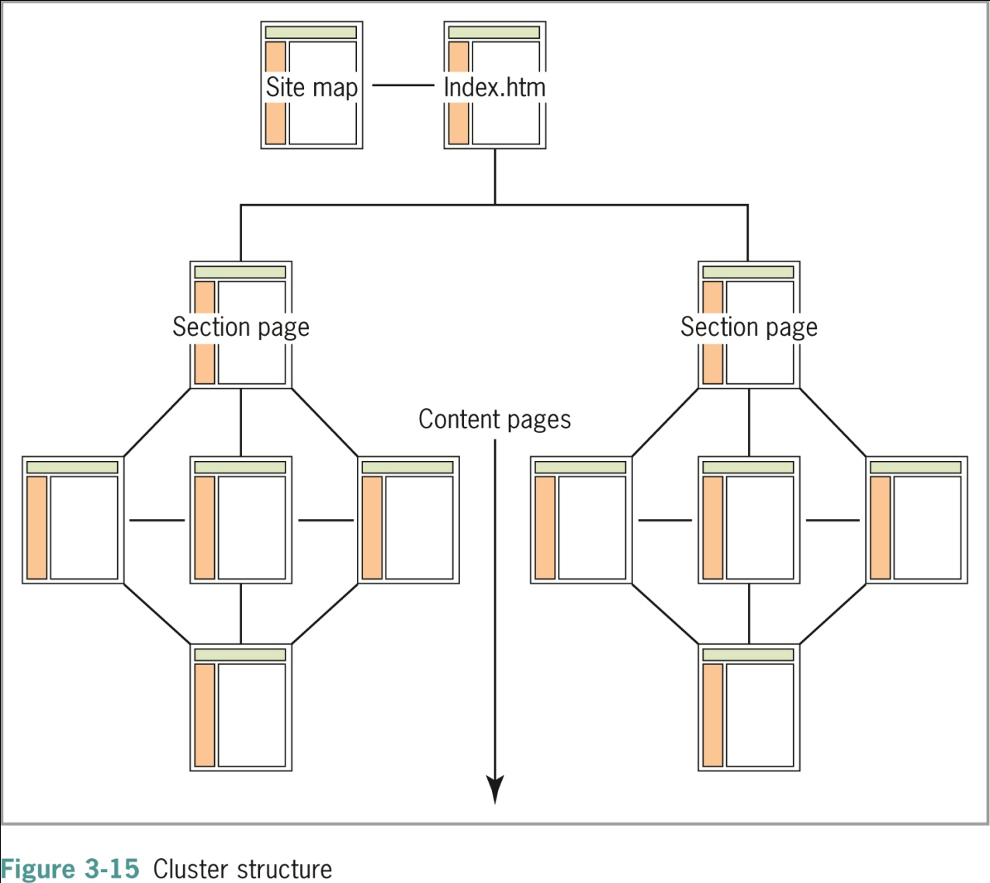
Cluster Structure
Web Design Principles 5th Ed.

Slide 46
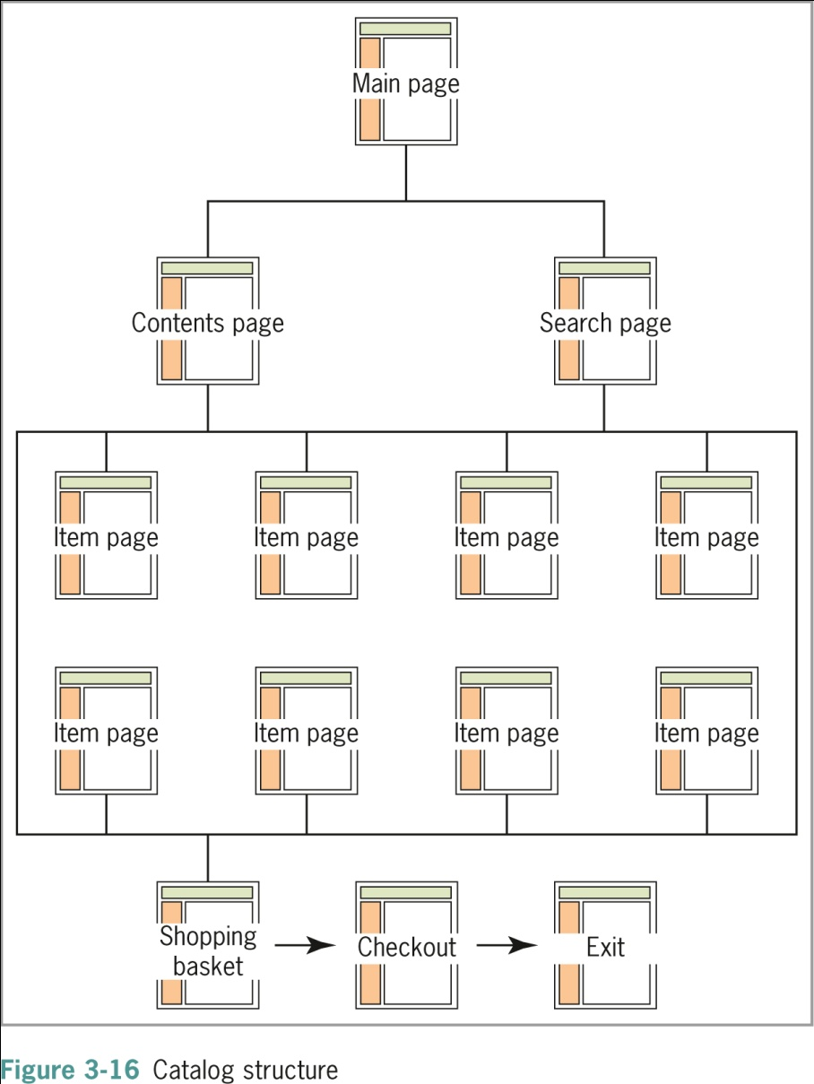
Catalog Structure
Web Design Principles 5th Ed.

Slide 47
Publishing Your Web Site

Slide 48
Choosing a Web Hosting Service Provider
The Web hosting service hosts your Web site
Select a Web hosting service appropriate to the size of your Web site
Check for the following features
  DSL and cable access
  Accessible technical support
  E-mail addresses
  SQL database support
  Secure socket layer support
Web Design Principles 5th Ed.

Slide 49
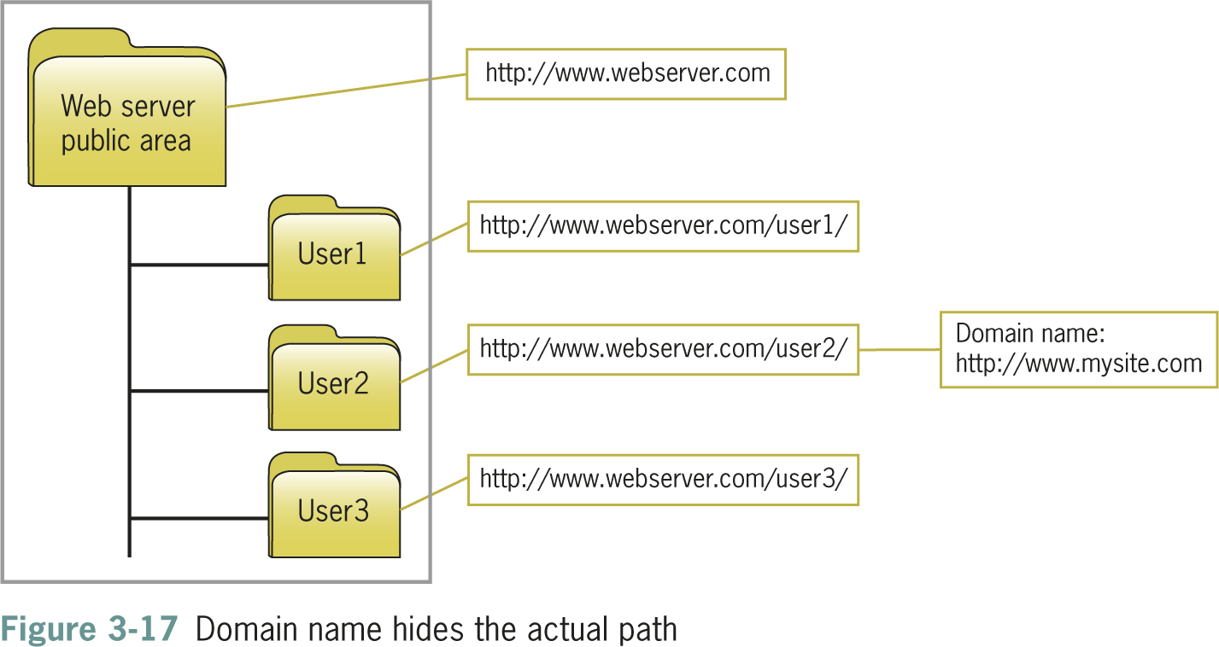
Registering a Domain Name
Web Design Principles 5th Ed.

Slide 50
Web Hosting Service Comparison Checklist
Is the Web host local or national?
What are the details of the different hosting packages?
Are there bandwidth limits for the number of visitors your site receives per month?
Does the Web host offer technical support?
How many e-mail addresses do you get?
Does the Web host provide software and offer support for the latest connection technologies?
Does the Web host offer enhanced services?
Web Design Principles 5th Ed.

Slide 51
Uploading Your Files with FTP
To publish pages on the Web, you must send your HTML code, images, and other files to the Web server
FTP software let you transfer the files
Some HTML-editing software has built-in FTP
There are many shareware and freeware FTP programs to choose from
Web Design Principles 5th Ed.

Slide 52
Testing Your Web Site
Multiple browsers
Multiple operating systems
Connection speeds
Display types
Link testing
Web Design Principles 5th Ed.

Slide 53
Usability Testing
Vary your subjects
Formalize your testing
Develop a feedback form
Web Design Principles 5th Ed.

Slide 54
Summary
A successful Web site is the result of careful planning
Become familiar with the Web development lifecycle
Start with pencil and paper
Write a site specification document
Identify the content goal
Analyze your audience
An effective site is a team effort
Web Design Principles 5th Ed.

Slide 55
Summary
Create portable filename conventions
Create an information structure for your site
Shop carefully when seeking a Web host
Learn to use FTP software
Test, test, test!
Web Design Principles 5th Ed.

